Slide 1
Care Coordination Referrals

Slide 2
Care Coordinator Responsibilities:
Assist with patient choice and placement in post-acute care facilities. (SNF, LTACH, Inpatient Hospice, Inpatient Psych, & IPR). We work closely to ensure insurance coverage and that facilities are in-network with the pt.'s insurance provider.
Ensure that the patient has prescribed home supplies and equipment, prior to discharge
Assist patients with choice and place referrals for Home Health and Hospice care
Arrange home IV Antibiotics/Infusions, Tube Feeding, TPN.
Prior-authorizations for home medications, if needed
Suggest cost reduction programs for discharge medications (GoodRx, prescription discount cards, etc.)
Place referral for Cardiac/Pulmonary Rehab
Place referral for Neuro Rehab and Day Neuro Rehab
Assist with setting up transportation (wheelchair van and ground non-emergent ambulance) to discharge location
Care Coordination referrals will be addressed as soon as possible.
We will make every effort to complete orders same day. We have limited coverage on weekends

Slide 3
Things we can provide some assistance with:
Instructions on how to place care coordinators orders
Guidelines for social programs including but not limited to: Medicaid, disability, food stamps, WIC, housing assistance, etc.
Insurance assistance-we can provide some information but this is typically handled through Financial Services
Financial guidance for hospital bills and fees - typically handled through Financial Services
Information about how to replace existing DME – complicated process and may not be covered by insurance
Information and referrals to Inpatient Substance Abuse programs – facilities require it be pt initiated
Information and assistance with arranging private duty nursing (nurses/sitters/24hr aides). This is not covered by insurance and is private pay only
Information and assistance with placing patients in memory care, assisted living, etc. These are not covered by insurance and are private pay only.

Slide 4
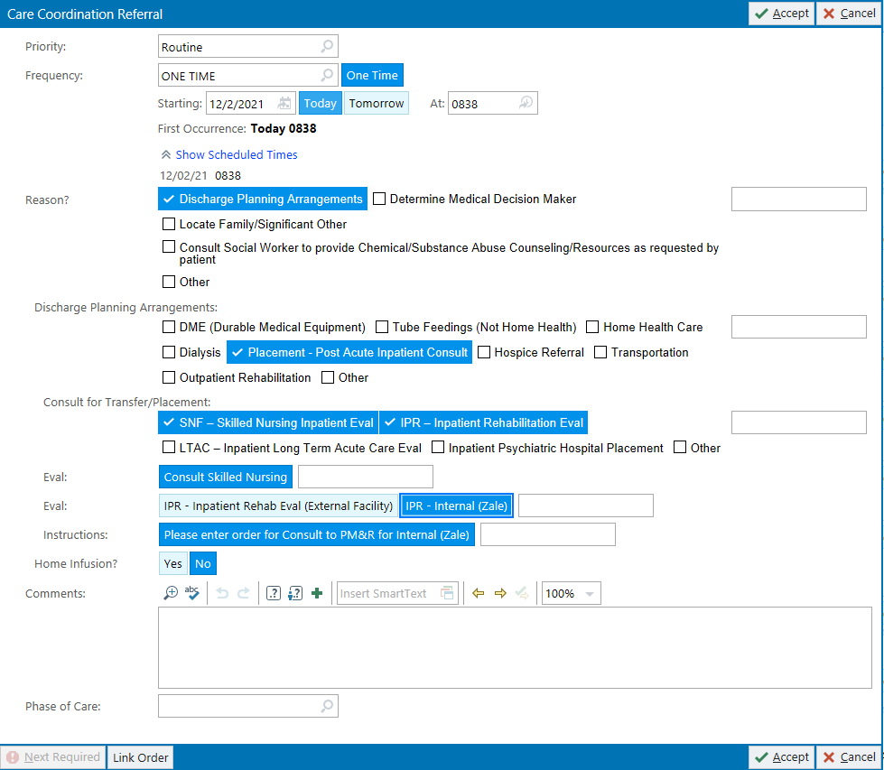
Placing an order for placement: Please use buttons. There may be hard stops you will need to complete!
Placement: Select type of placement
If patient needs placement at SNF or IPR please order IP Eval and Treat for PT and OT
PM&R must be consulted for consideration by Zale Rehab, in addition to a Care Coordination Referral order. A referral to Zale CANNOT be sent without a PM&R note. It is the responsibility of the provider to order consult, not the care coordinator.
Medicare requires that patient has choice of facility. This includes IPR and LTACH. Please do not tell patient that they will be going to a specific facility. This depends on insurance coverage and therapy notes.

Slide 5
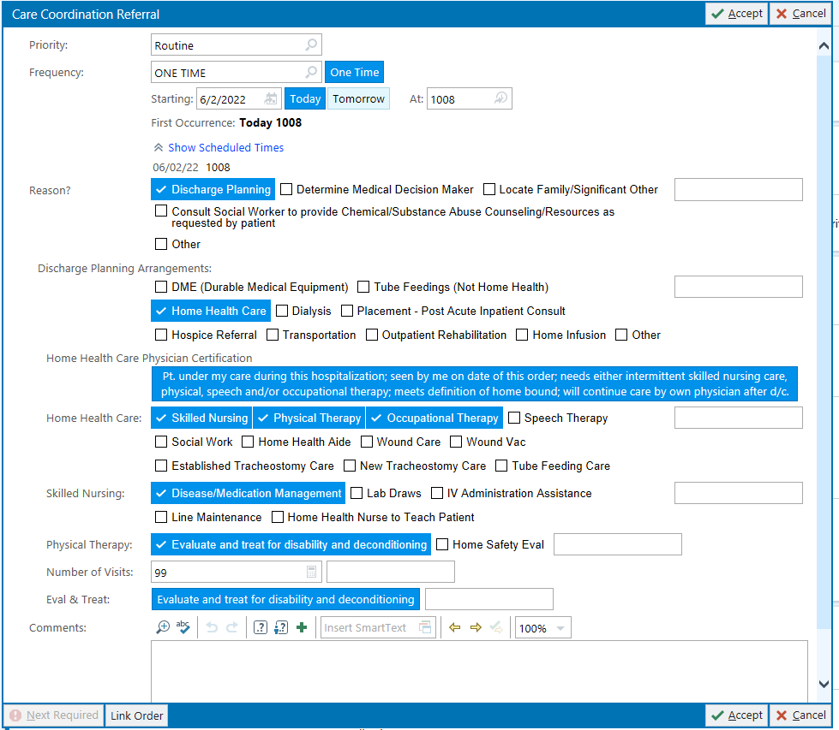
Placing an order for Home Health:
Please use buttons. There are hard stops you will need to complete!
Home Health Care: Home Health agencies work specifically off the orders provided.
Orders must include: each discipline desired- Skilled Nursing, PT/OT/ST, social work & home aide. The number pf visits should be limited and renewed, if indicated by PCP.
Nursing or PT must accompany OT and Social Work orders. Nursing need must accompany a home health aide
Wound care: Identify the part of body, supplies needed and specific intervention (ok to copy from wound care note)
Labs: include frequency and name of physician that will be following labs.
PICC, Central line, etc. please include Skilled Nursing for specific line care and weekly maintenance
PCN drain: please include Skilled Nursing for PCN drain care and maintenance
PleurX catheter: please include Skilled Nursing for PleurX cath care/maintenance and teaching
Tube Feeds or TPN, please include Skilled Nursing for (TPN or tube feeds) care and maintenance
Examples: PT/OT treat for debility and deconditioning; Skilled Nursing for vital checks and medication management

Slide 6
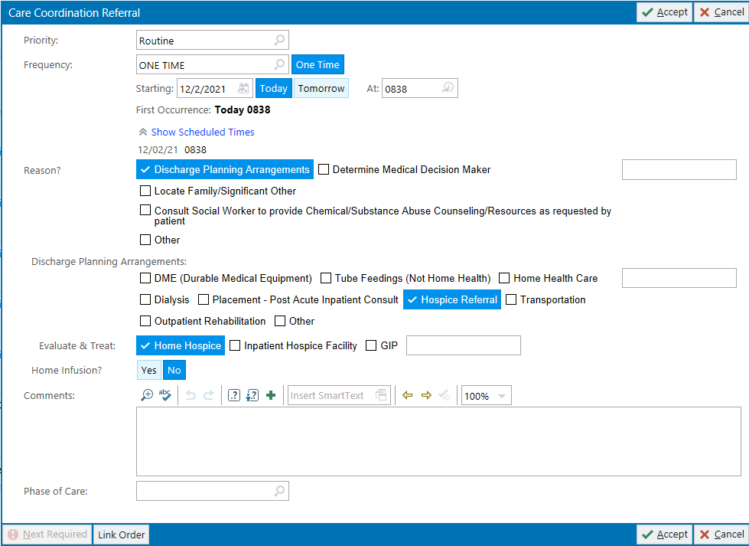
Placing an order for Hospice: Please use buttons. There may be hard stops you will need to complete
Hospice order:
Order must state “Home Hospice” “Inpatient Hospice Facility” or “GIP”
Patient must be provided with choice of hospice company
GIP Hospice is for patients in need of aggressive symptom management that precludes management in other settings

Slide 7
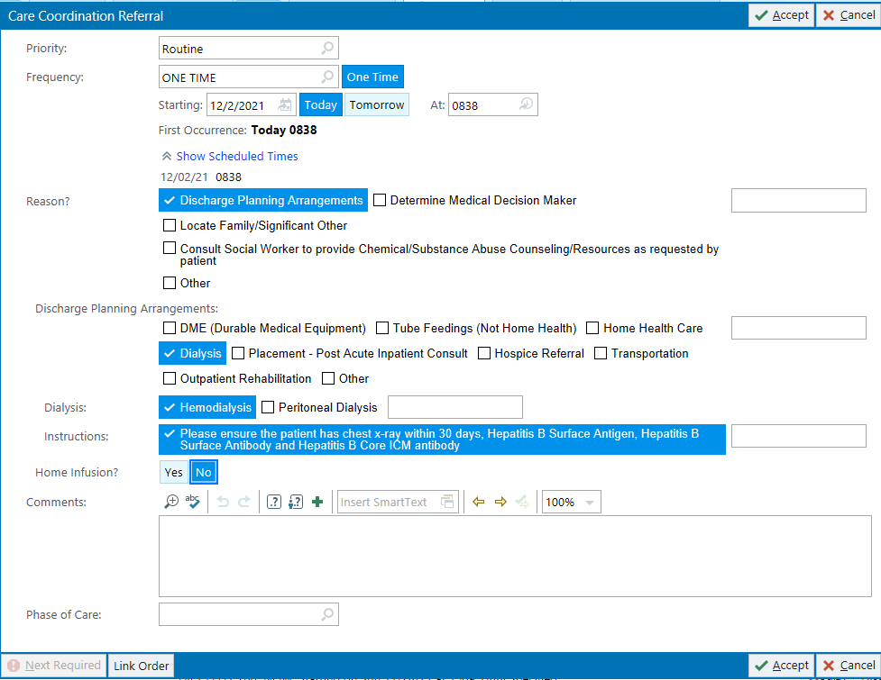
Placing an order for Hemodialysis:
Hemodialysis: This process traditionally takes 48-72 hours.
Please order the following labs & X-Ray: Hep C, Hep B Surface Antigen, Hep B Surface Antibody, & Hep B Core Antibody, Chest X-Ray
3 inpatient HD treatments will be needed
If patient is already established with HD center before admission and states they want to change HD center, s/he should address the issue upon return to the dialysis center.
Some unfunded patients may qualify for Medicare funding for dialysis.

Slide 8
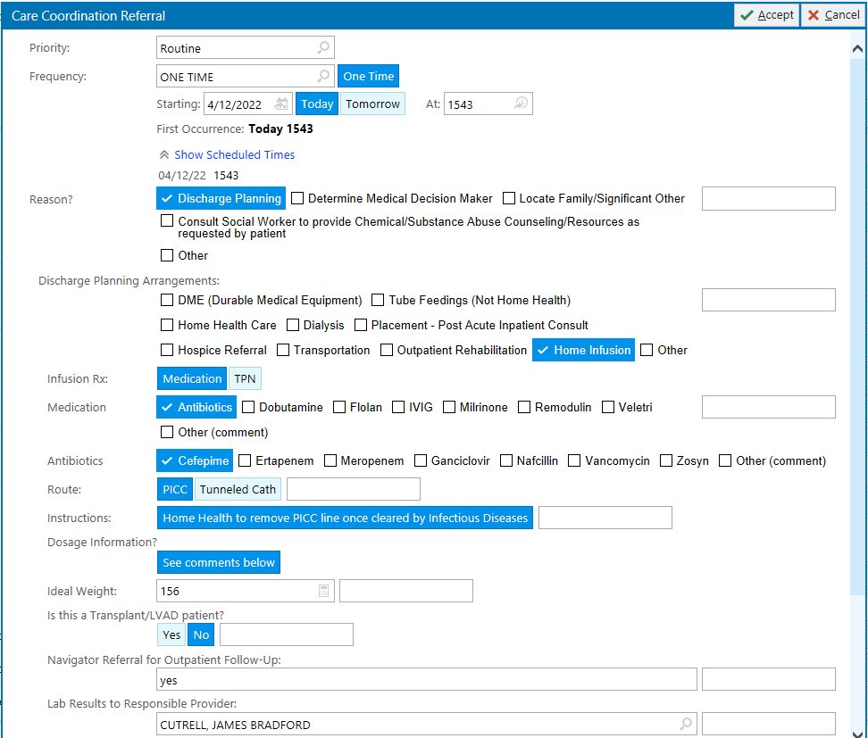
Placing an order for Home IV Antibiotics
(Insert detailed instructions here)
IV Antibiotics Orders: This process also applies to home TPN orders.
Must be ordered within 48 hours of discharge.
We need a little notice so please order prior to day of discharge. Patient must be taught by infusion company and medication must be delivered prior to next dose
Must include Home Health Skilled Nursing
Order PICC Line ASAP. Details on line placement progress note must be sent before service is accepted
Please copy and paste full instructions into comment section.

Slide 9
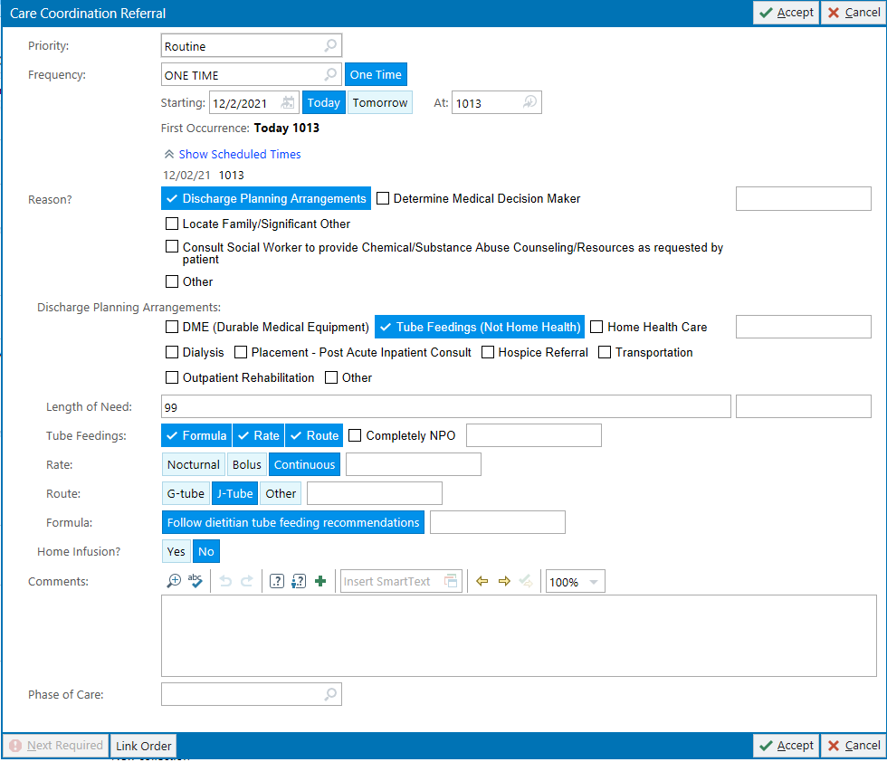
Placing an order for Tube Feeding: Please use buttons. There may be hard stops you will need to complete
Tube Feedings:
Orders must include: formula name, delivery method, rate, anticipated duration of feedings, free water requirements, instructions for care of the tube & home health instructions as needed.
For Medicare to cover, it must be documented, in a progress note, the formula provides 100% of the patient’s nutritional requirements and is needed for at least 90 days.
Please copy and paste dietician’s instructions into comments section of the order.

Slide 10
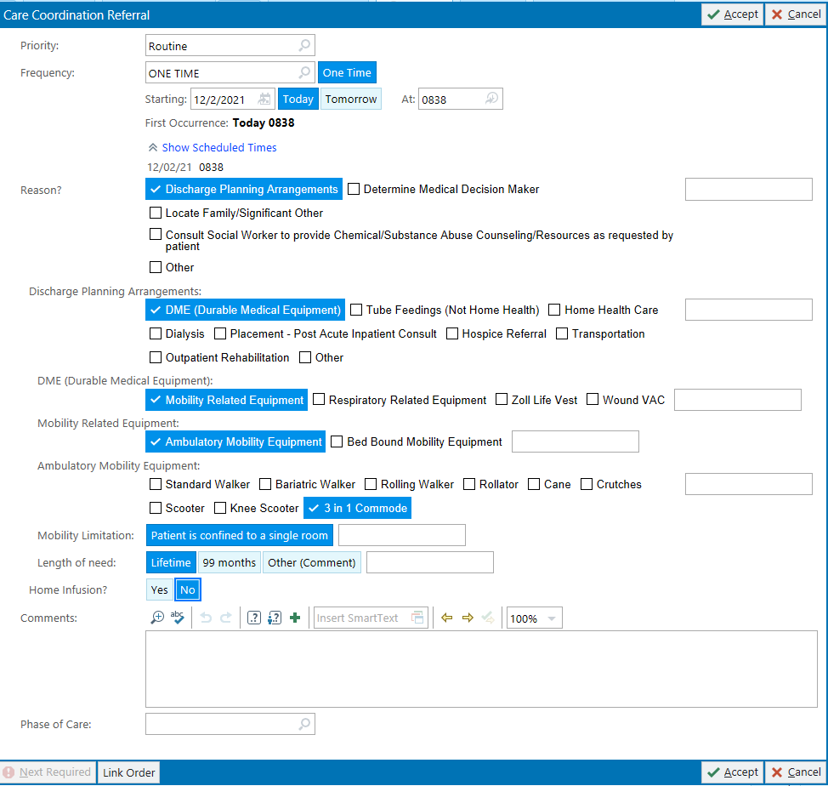
Placing an order for Equipment
Durable Medical Equipment: Orders must include: “rolling walker, rollator, wheelchair, hospital bed” with length of need & related diagnosis.
3 in 1 commode: patient needs to be physically incapable of utilizing regular toilet facilities for insurance to cover. Must be confined to a single room; confined to 1 level of the home environment and there is no toilet; or confined to the home and there are no toilet facilities in the home.
Home Oxygen: Please order RT Walking Oximetry test to determine medical necessity for home oxygen.
Patient must desat to 88% or less on Room Air to qualify.
Sats must be within 48 hours of d/c.
Order must include: diagnosis, rate, frequency, delivery method & duration, portable tanks & concentrator.
Example: ““Home oxygen at 2 LPM via nasal cannula continuous with portability for (include diagnosis)””
Shower Chairs and related bathroom equipment are not covered by insurance. A 3-in-1 commode cannot to be used strictly as a shower chair replacement.
Wheelchair: it must be documented that patient can’t ambulate with walker or cane
Wound Vac: Order must state, “home wound vac”
If Vac is placed in surgery, please write wound measurements, in the OP report, as it is essential documentation for the process.
Or ensure WOCN has seen patient in order for s/he to input required measurements.
Once application & supporting documentation have been submitted, insurance approval can take hours.
Residents cannot sign wound vac orders
Rolling Walker: patient must have a mobility limitation that significantly impairs his/her ability to participate in 1 or more mobility related ADLs in the home; the patient is safely able to use the walker; and the mobility deficit can be sufficiently resolved with the walker
Heavy Duty Walker: patient meets standard criteria for a rolling walker and weigh more then 300lbs.

Slide 11
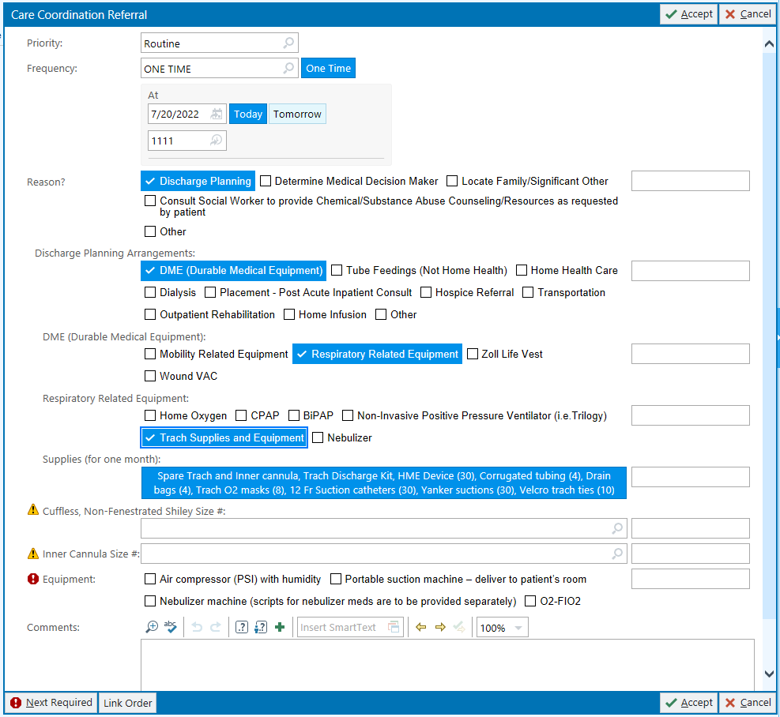
Ordering Trach and Laryngectomy supplies

Slide 12
Price checks:
Medications that need to be reviewed for prior auth or cost MUST to be sent to a pharmacy before Care Coordination can review.
CUH pharmacy is preferred.
Please send an order or Secure chat after the medication has been ordered
Medical Supplies MUST have a detailed Care Coordination order. This will be sent to vendor who will run the insurance. This is usually not a same day process

Slide 13
Other Notes:
Please contact your Care Coordinator daily to run the patient list. Secure chat, telephone, or in-person visits are all acceptable.
For Substance Abuse consults, patient will be provided a list of resources only.
Sitters must be discontinued for 24hrs prior to admission to facilities.
Please follow up with RN for necessity of sitter and when sitter is to be removed.
“Close Observation” outside the patient’s room is considered the same as a sitter. Please avoid ordering this.
Please place separate orders for different categories of referrals
Example: DME, Home Abx, Tube feeding, Home Health, and Placement
Outpatient Therapy - patient will need a paper script to take to their chosen facility or an internal referral, if UTSW is to be used

